Slide 1

Advanced Programming Practices (SOEN 6441)
Project Build 2 – Team 19
Meetkumar Kalariya | 40293692
Nen Patel | 40291812
Rushin Makwana | 40221949
Tushar Jain | 40274220
Amal Gupta | 40293339

Slide 2




Tools and Libraries used for the project
IntelliJ IDE
JDK 21 and Junit 5
GitHub for Version Control and Progress Board
GitHub Actions for CI/CD workflow

Slide 3
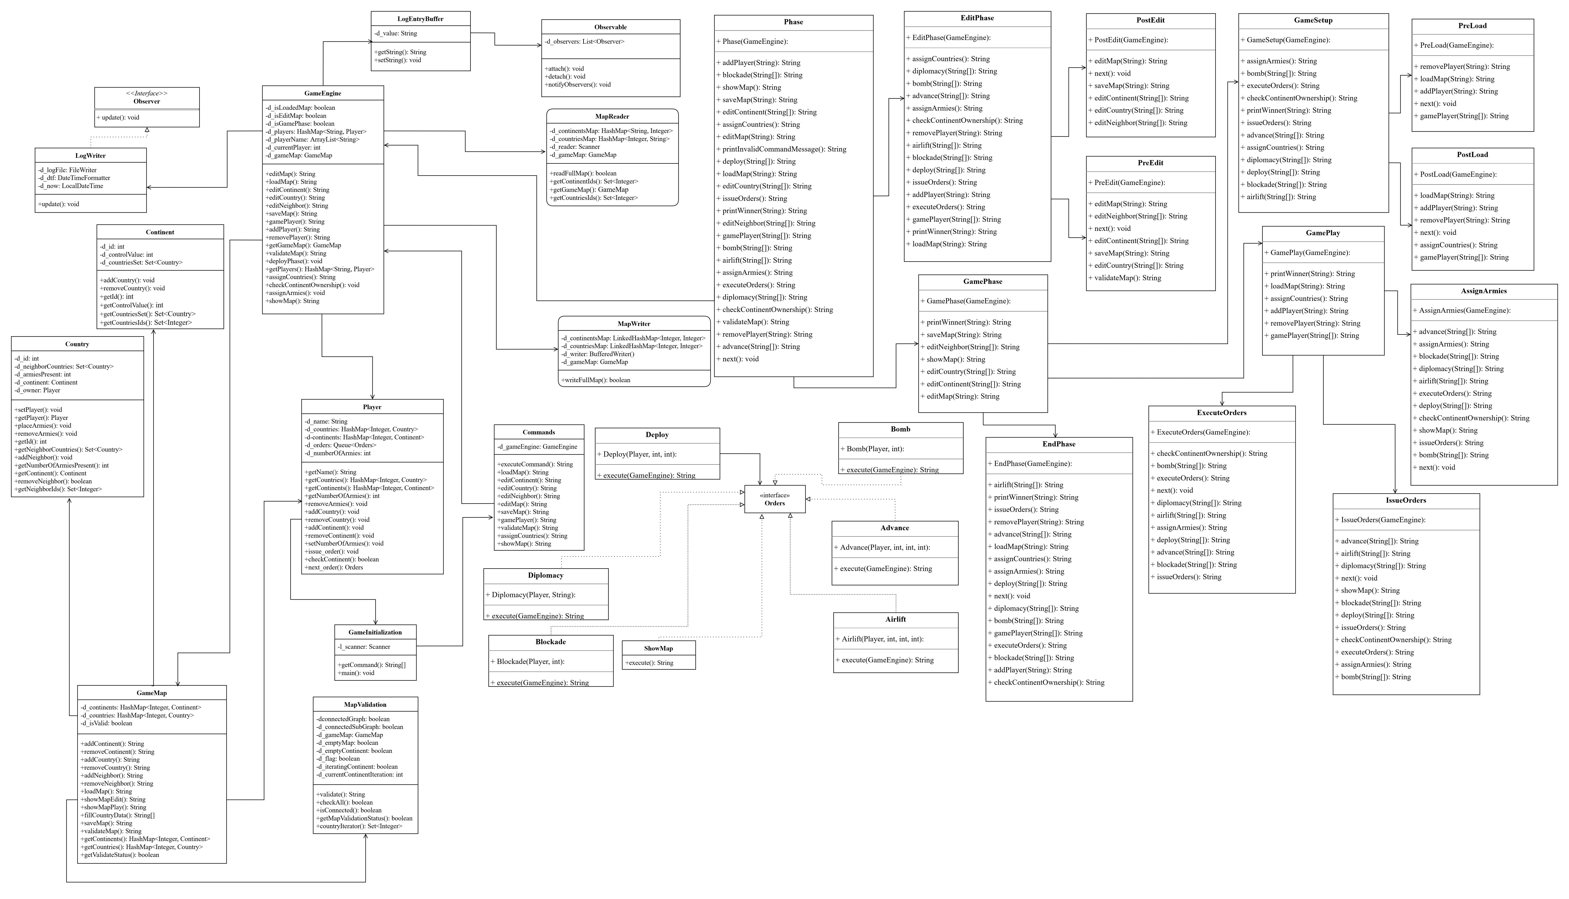
Architectural Design Diagram
Notes:
First up we have the Architectural diagram for our software.

Slide 4
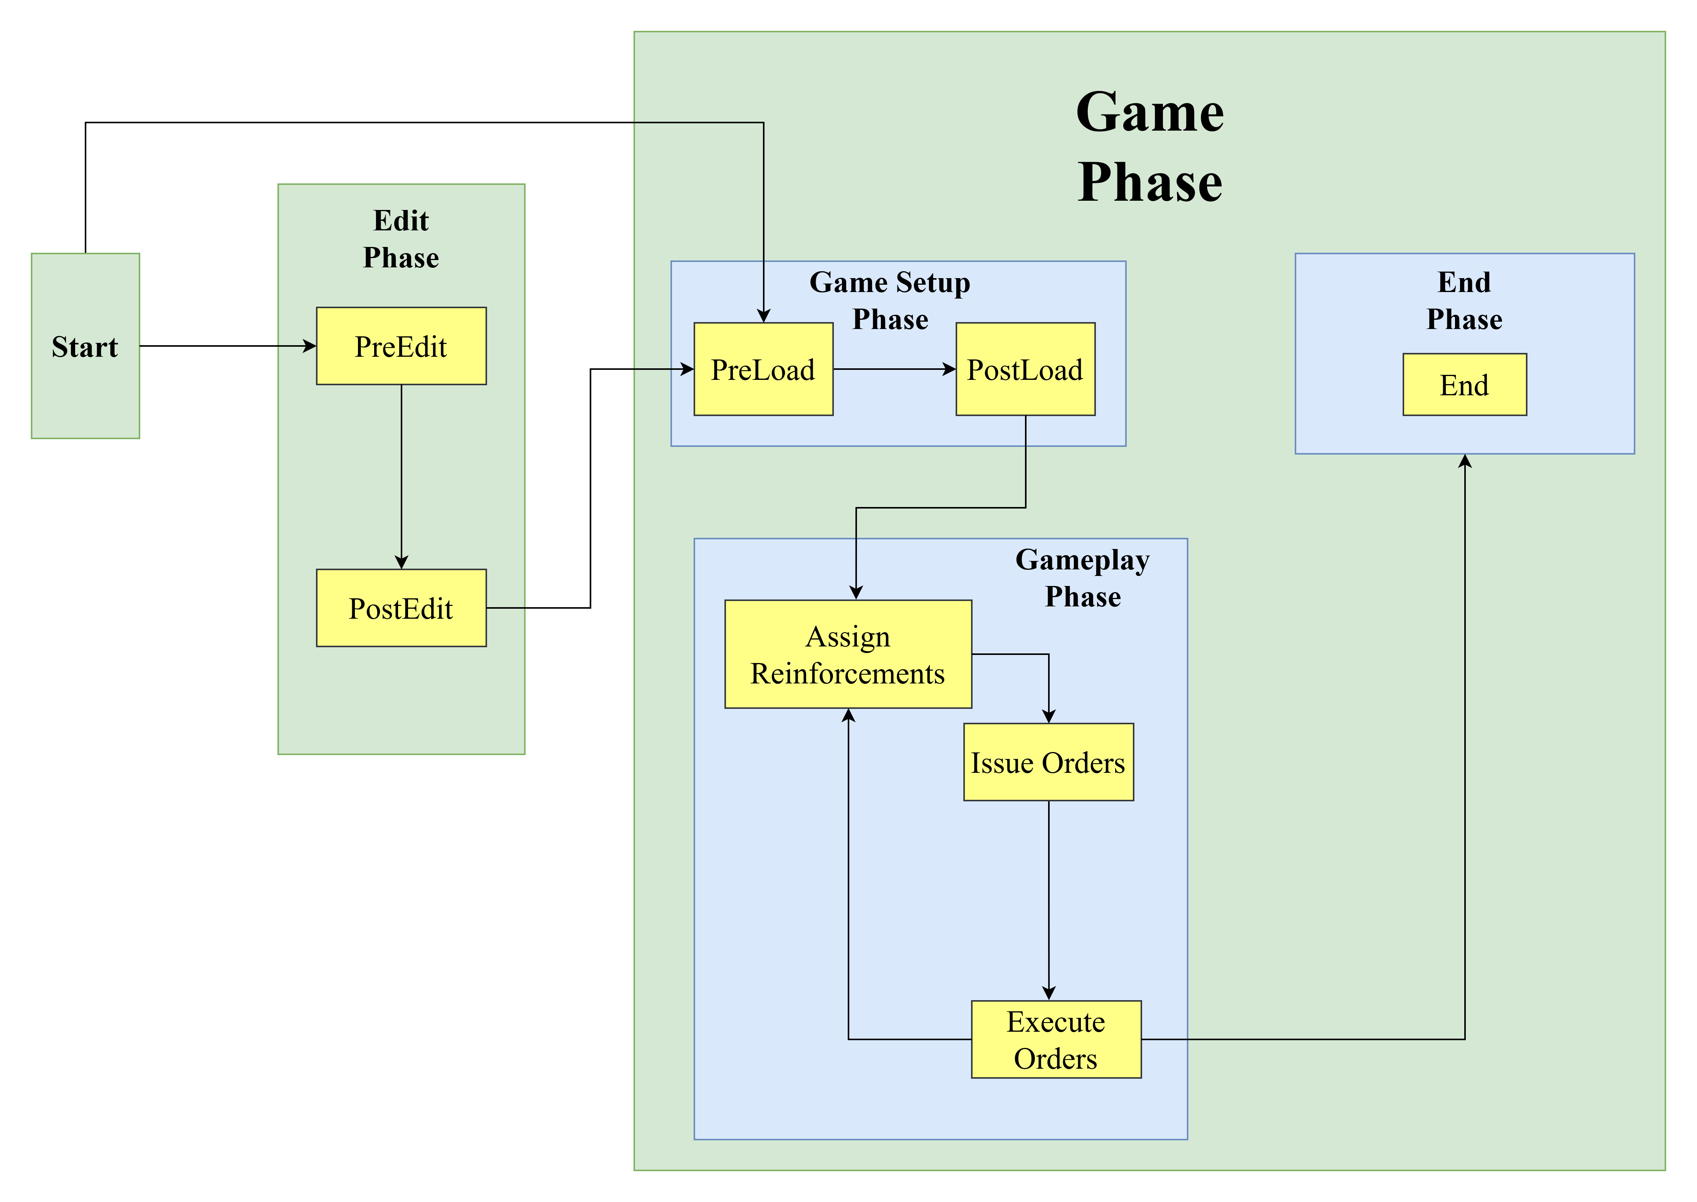
Architecture of State Pattern

Slide 5
Refactoring
Notes:
Let me give a brief introduction for our class.

Slide 6
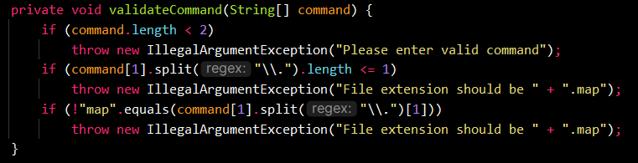
Refactoring targets
1) validateCommand method implemented in edit, load and save phase.

Slide 7
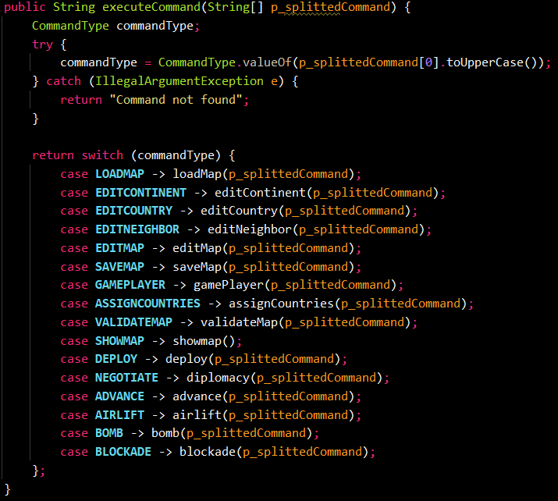
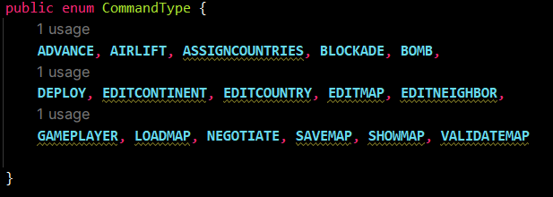
Refactoring targets
2) Enum implemented in Commands.java.

Slide 8
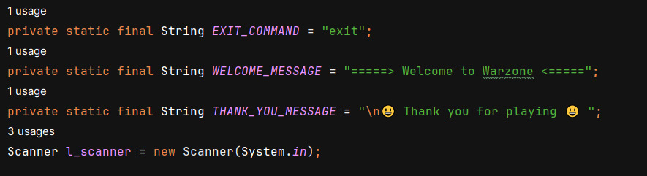
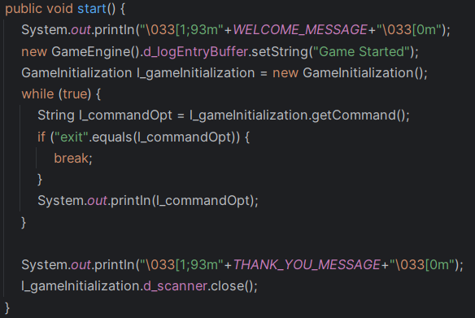
Refactoring targets
3) Magic String replacement implemented in GameInitialization.java.

Slide 9
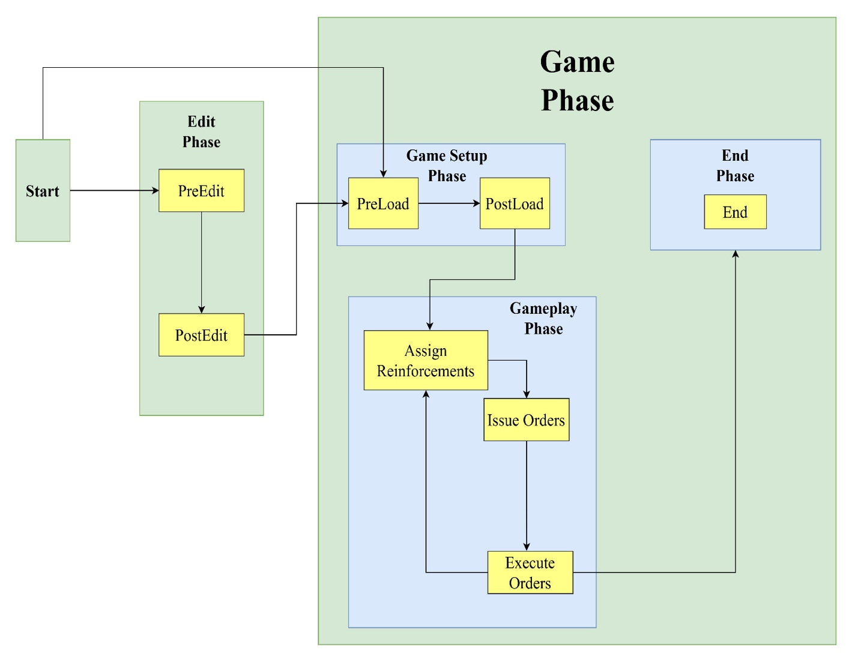
Refactoring targets
4) State Pattern Implementation – The state pattern in Java is a behavioral software design pattern that allows an object to alter its behavior when its internal state changes. The state design pattern is generally used in cases when an object depends on its state and its behavior must be changed during run time depending on its internal state.
In the project, refactoring for the build 1 is done to support state pattern design.

Slide 10
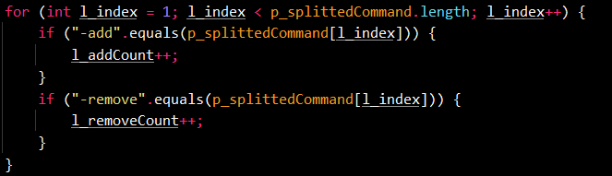
Refactoring targets
5) Null pointer exceptions were removed during the refactoring phase. These were removed by introducing a specific syntax for equals method all throughout our project.

Slide 11
Java Class Brief Introduction
Notes:
Let me give a brief introduction for our class.

Slide 12
Observable.java
This Class will implement the connection/disconnection mechanism between observers and observables (subject).
It also implements the notification mechanism that the observable will trigger when its state changes.

Slide 13
LogEntryBuffer.java
This will inherit Observable class whose function is to obtain the outputs that are obtained after executing commands.
The class also contains methods to get and set the string of output.

Slide 14
LogWriter.java
This class will inherit Observer Interface and whose
function is to write the output to the log file.
It also has method to show the current timestamp and the state changes have taken places during execution
Notes:
Map ops and player ops commands

Slide 15
EditPhase.java
The EditPhase is an abstract class which is inherited from the Phase class to support commands valid in editing phase

Slide 16
PostEdit.java and PreEdit.java
The PostEdit class is inherited from the EditPhase class to support commands valid in post editing phase.
The PreEdit class is inherited from the EditPhase class to support commands valid in pre editing phase.

Slide 17
GamePhase.java
The GamePhase class is an abstract class inherited from Phase class.
It is class to support commands valid in game phase(general commands)

Slide 18
Advance.java
This class will execute Advance order given by user on specified country.
This will transfer specified no. of amies from one country to other if player owns the country otherwise it will attack with specified armies.

Slide 19
Preload.java and Postload.java
The preload java class will be executed after map is saved successfully or at the start of the game, it contains methods to load a map.
The preload will do necessary steps before game load.
The postload java class will be executed after preload class, it contains methods to add or remove players from game and to assign countries randomly to players.
The postload will do necessary steps after game load.

Slide 20
Bomb.java
This class represents the bomb card. The Bomb Card allows you to target an enemy or neutral territory and kill half of the armies on that territory.
Since it kills half of the armies on a territory, it's most effective when your opponent builds a single large stack of armies. Therefore, when opponent has a Bomb Card, your are separated smaller stacks when possible to reduce its effectiveness.
Notes:
Current status of the gamemap

Slide 21
Airlift.java
This class represents the airlift card. The Airlift Card allows you to transfer your armies from one country to another. Each time you play one, you can do a single transfer from any of your territories to any other territory of yours.
Similar to a normal transfer, those armies can't do any other action that turn.

Slide 22
Blockade.java
This class will execute order given by user to place Blockade Card on specified country.
This card will increase army by 3 times and assign owner as a Neutral Player.
Notes:
This class is used to deploy armies by the player which they own.

Slide 23
Diplomacy.java
This class will implement order given by user to place Diplomacy Card on specified country.
This card will be used to negotiate between two players so that neither can attack on each other during their turn.

Slide 24
Test Cases
We have also implemented the test cases for all the classes.

Slide 25
GitHub Progress Board
We have leveraged GitHub progress board template to track the task and their progress.

Slide 26
Thank You
Project Build 2 – Team 19
Meetkumar Kalariya | 40293692
Nen Patel | 40291812
Rushin Makwana | 40221949
Tushar Jain | 40274220
Amal Gupta | 40293339

